Slide 1
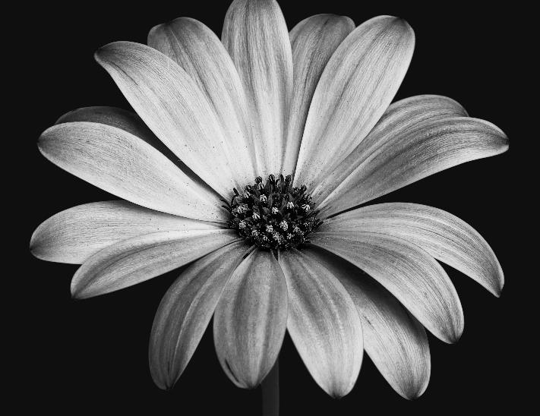
TITLE
Classification of various flowers using CNN

Slide 2
OUR Group Members
Name | ID
ANIK DAS | [19-41048-2]
PRANAY ACHARJEE | [20-42372-1]
SUDIPTA SAHA | [20-42143-1]

Slide 3
TABLE OF CONTENTS
Introduction
Dataset
Data Preprocessing
Model Building
Train and Testing
Result
Future Direction
Discussion
References

Slide 4

Introduction
We all come across numerous flowers on a daily basis. But we don’t even know their names at times. We all wonder “I wish my computer/mobile could classify this” when we come across a beautiful looking flower. That is the motive behind this article, to classify flower images. The main objective of this article is to use Convolutional Neural Networks (CNN) to classify flower images into 5 categories.

Slide 5

Dataset
Kaggle Dataset —
https://www.kaggle.com/alxmamaev/flowers-recognition
The 5 classes in the dataset are:
Daisy, 2) Dandelion,3) Rose,4) Sunflower and 5) Tulip.

Slide 6
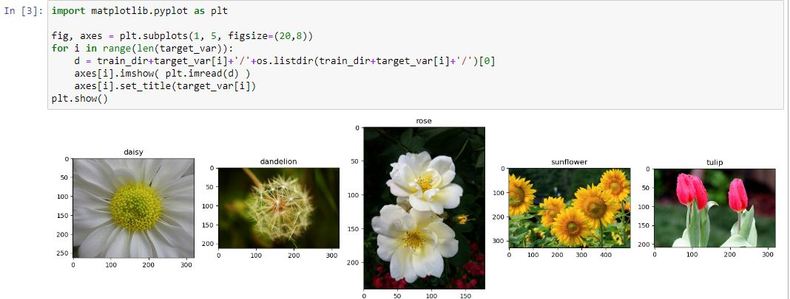
Data Preprocessing

Slide 7
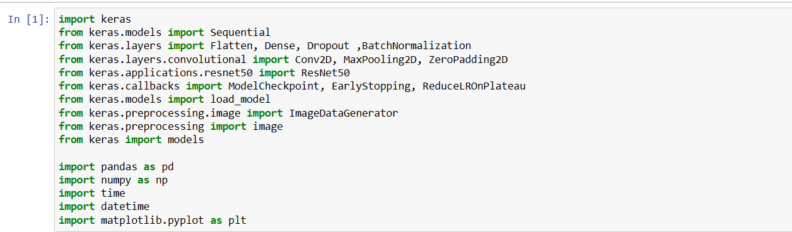
Imports Libraries
We will be using Tensorflow to implement the CNN, Matplotlib to plot graphs and display images, Seaborn to display the heatmap. The required libraries were imported in the following snippet.

Slide 8
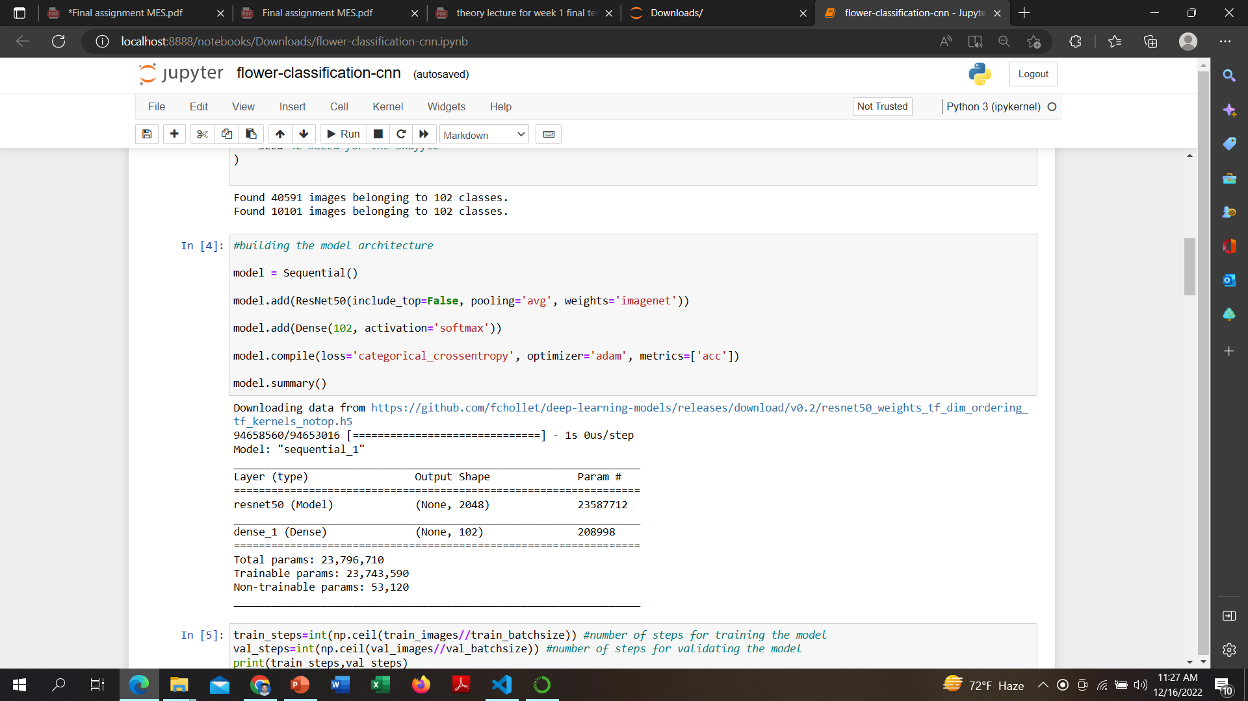
Model
The model consists of 2 Conv2D layers of 128 neurons each along with MaxPooling layers and followed by 2 Dense layers. We have used LeakyReLU here. ReLU might also provide good results here. The Loss is Categorical Crossentropy and Optimizer is Adam.

Slide 9


Callbacks
We have defined 2 callbacks
ModelCheckpoint — To save the best model during training
ReduceLROnPlateau — Reduce the learning rate accordingly during training
Train
The model is being training with a Batch Size = 32 and for 5 Epochs

Slide 10
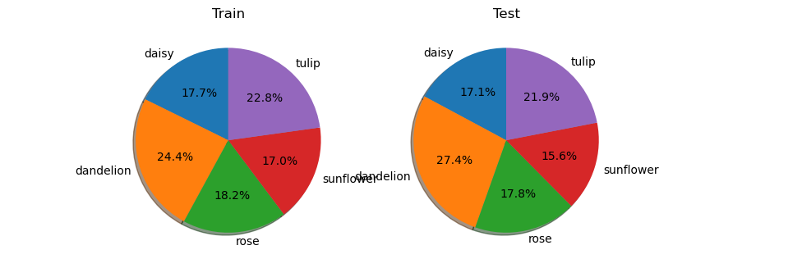
Train and Testing diagram

Slide 11
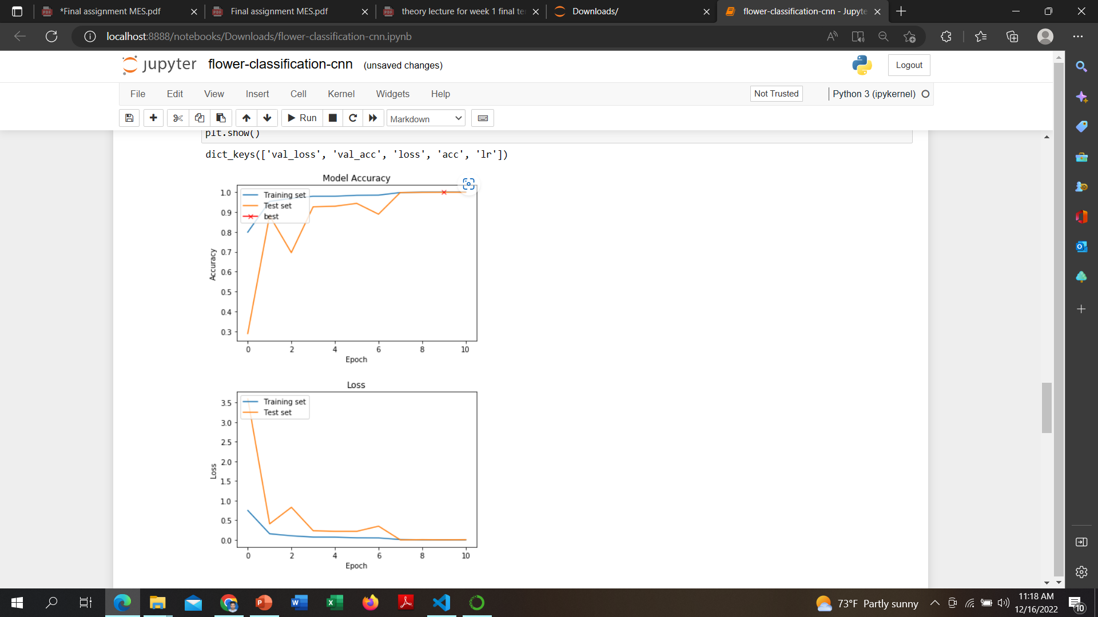
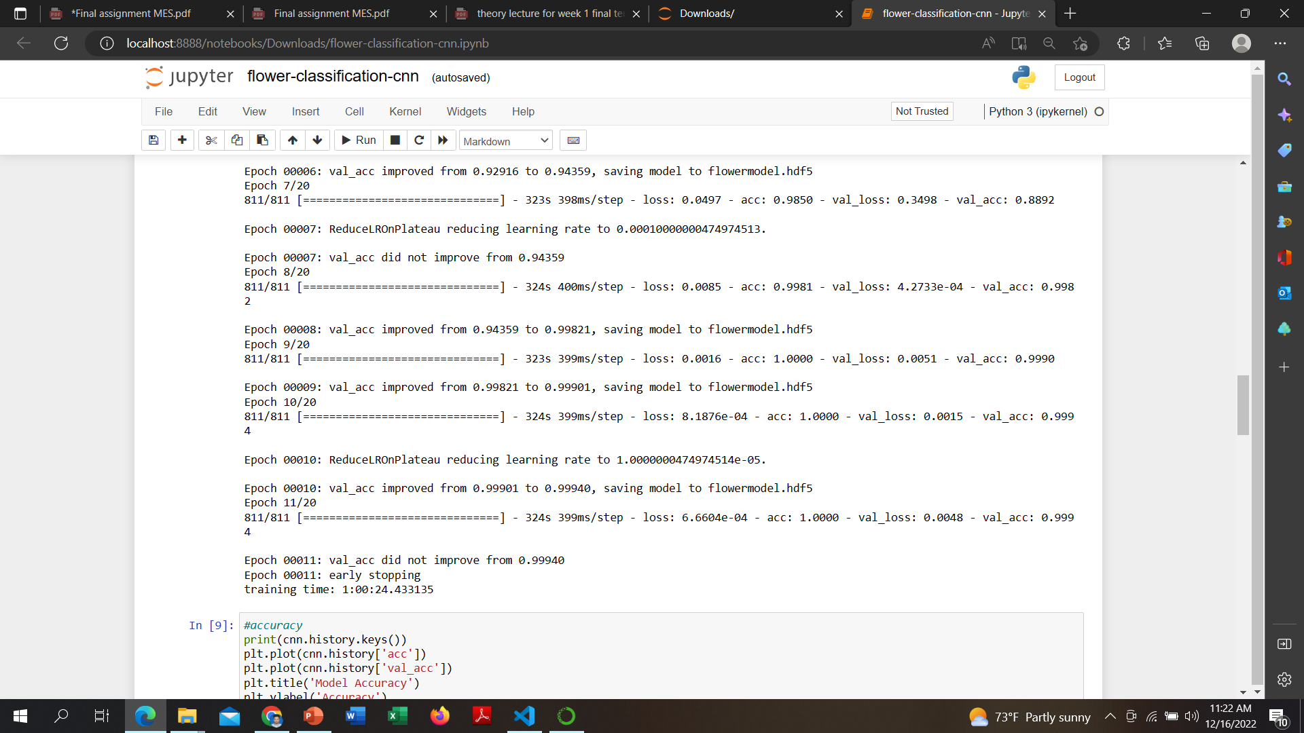
Result
The model reached a validation accuracy of 99.94% which is quite decent. And we can see that the model did not overfit a lot. So it’s quite a good model.

Slide 12
Discussion
From the result, it can be seen that, the accuracy of the model is not very precise. Because, we took input images as 1-channel GRAYSCALE and thus losing all the color information. For flower recognition accuracy, color information is one of the biggest factor along with the shape. The accuracy can be further optimized by taking 3-channel RGB inputs.

Slide 13
References:
Kenrick, P.: ‘Botany: the family tree flowers’, Nature, 1999, 402, (6760), pp. 358– 359
Das, M., Manmatha, R., Riseman, E.: ‘Indexing flower patent images using domain knowledge’, IEEE Intell. Syst. Appl., 1999, 14, (5), pp. 24– 33
R. Larson (Ed.): ‘ Introduction to floriculture’ ( Academic Press, San Diego, CA, USA, 1992, 2nd edn.)
Chi, Z.:‘ Data management for live plantidentification’, in D., Feng, W.C., Siu, H.J. Zhang(ED.): ‘ Mutimedia information retrieval andManagement’(Springer, BerlinHeidelberg, 2003), pp. 432– 457
Zhou, Hailing, Jianmin Zheng, and Lei Wei. "Texture aware image segmentation using graph cuts and active contours." Pattern Recognition 46, no. 6 (2013): 1719-1733

Slide 14


